Slide 1


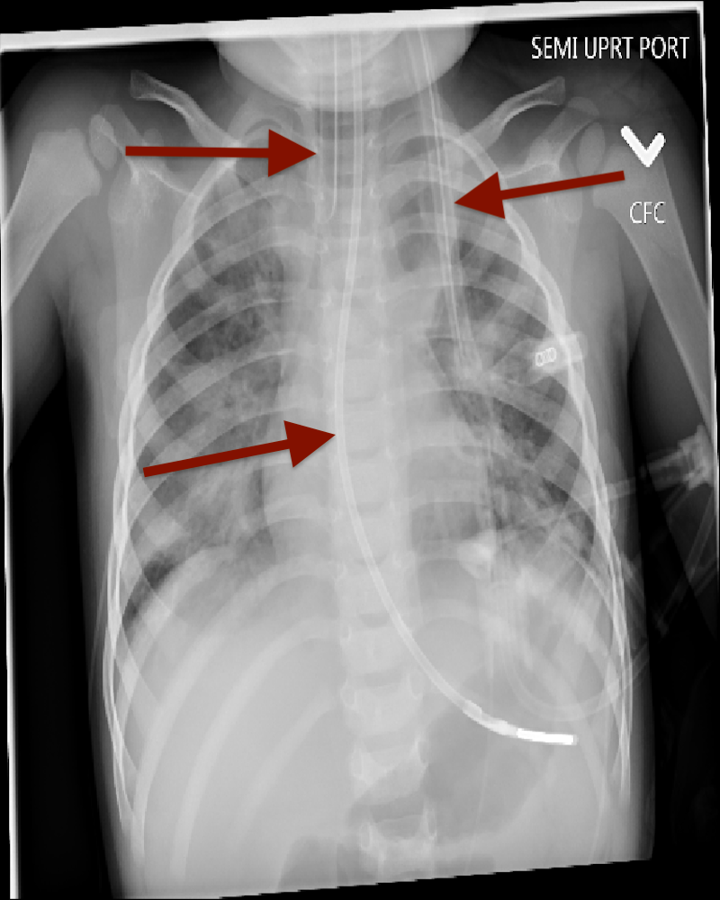
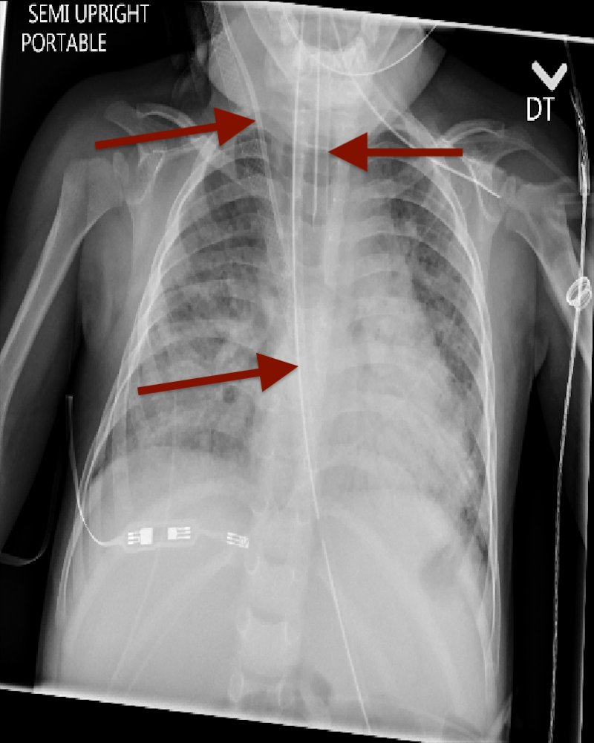
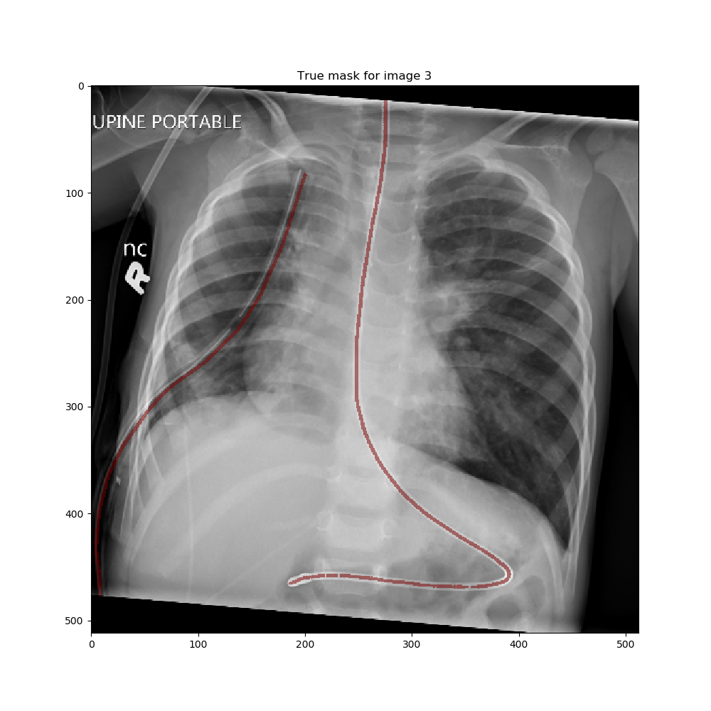
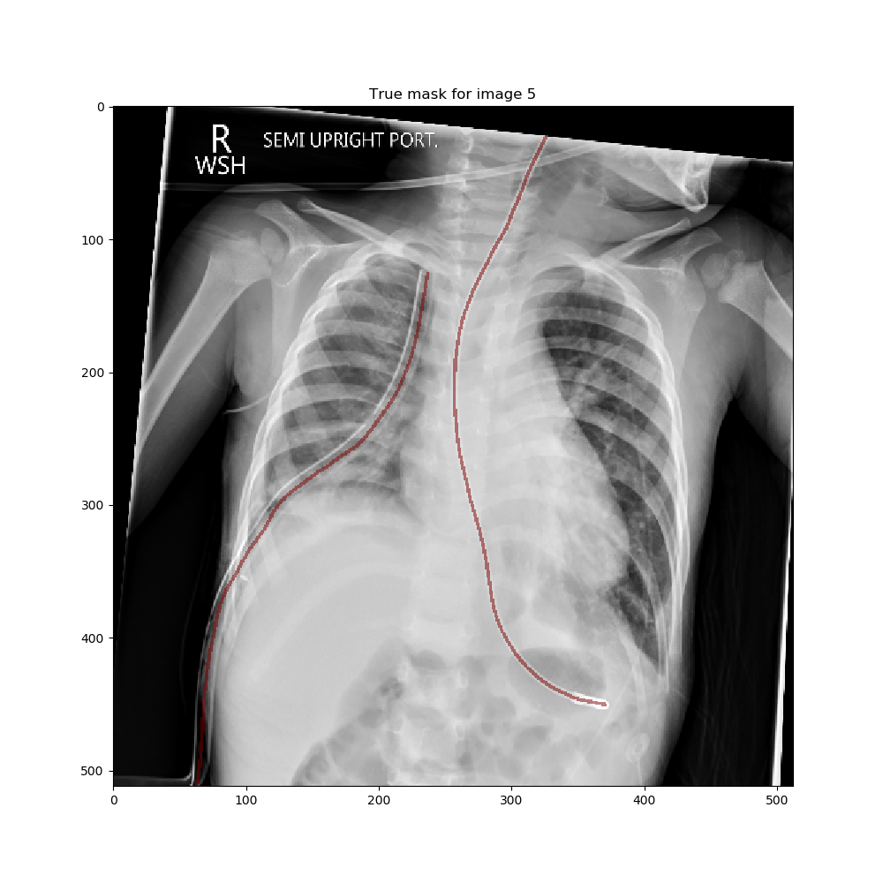
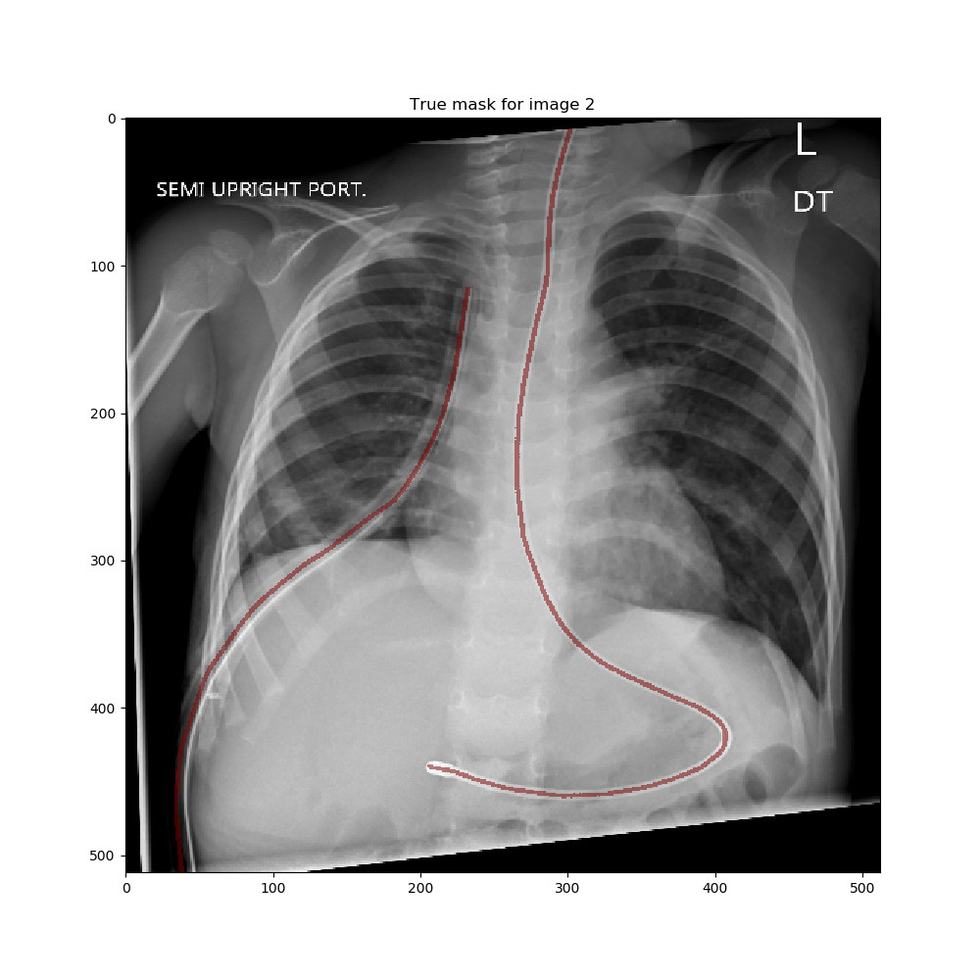
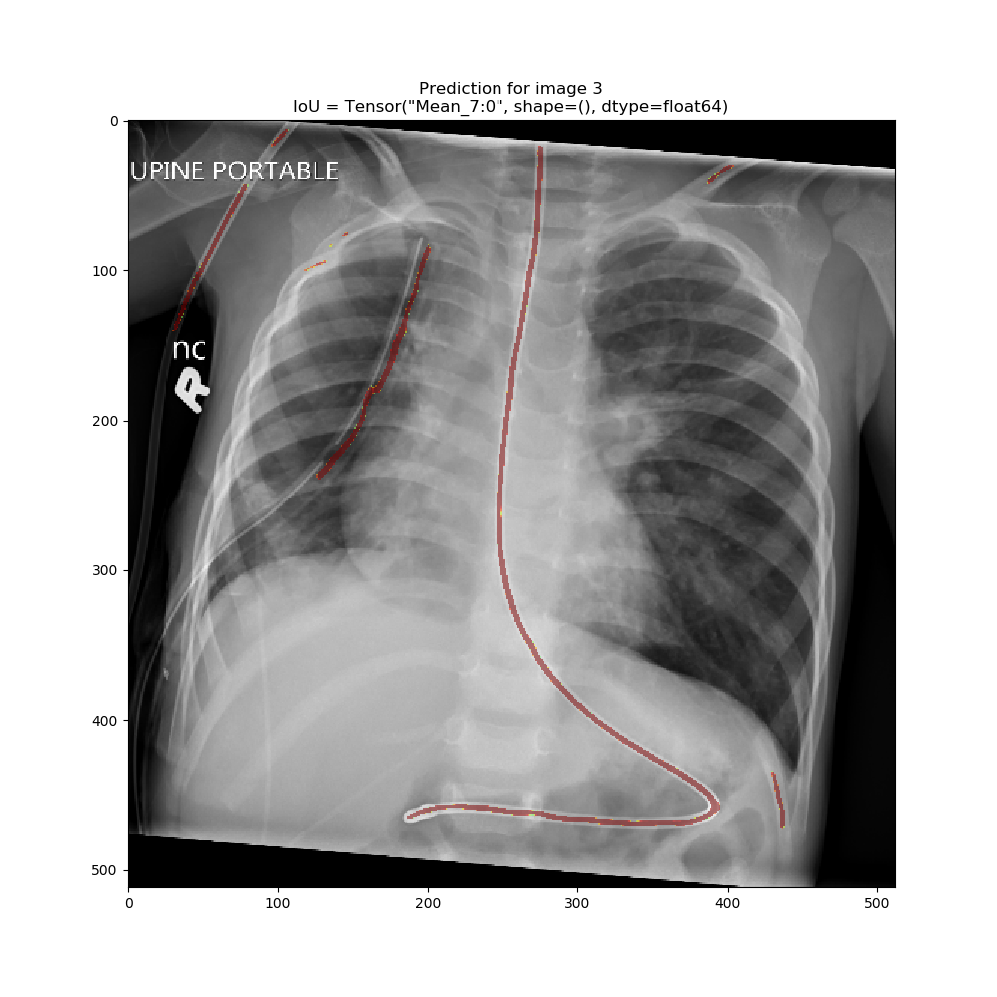
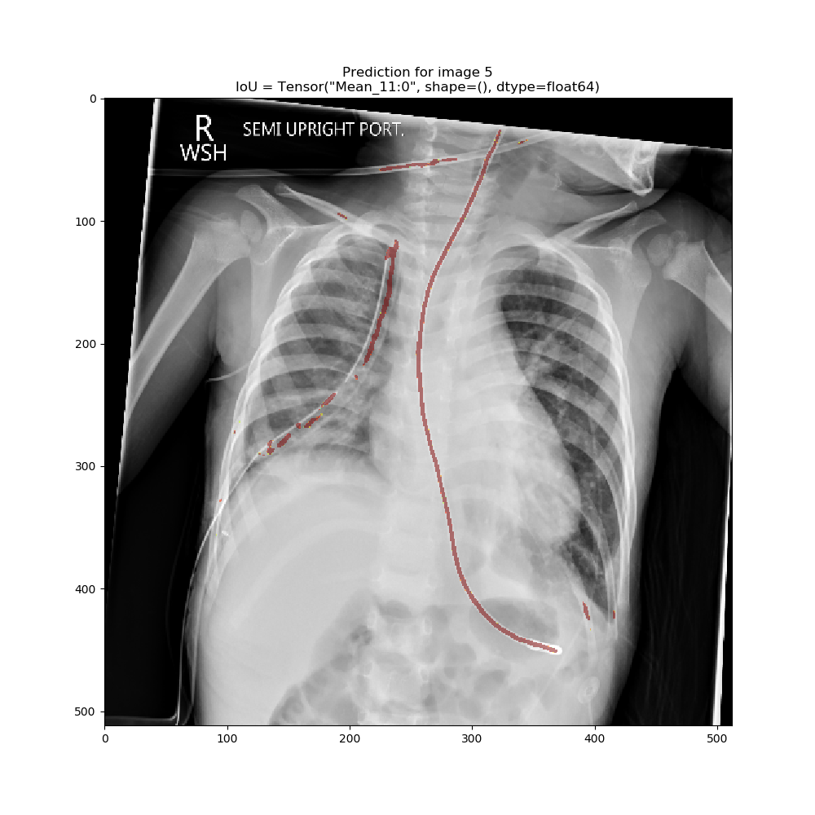
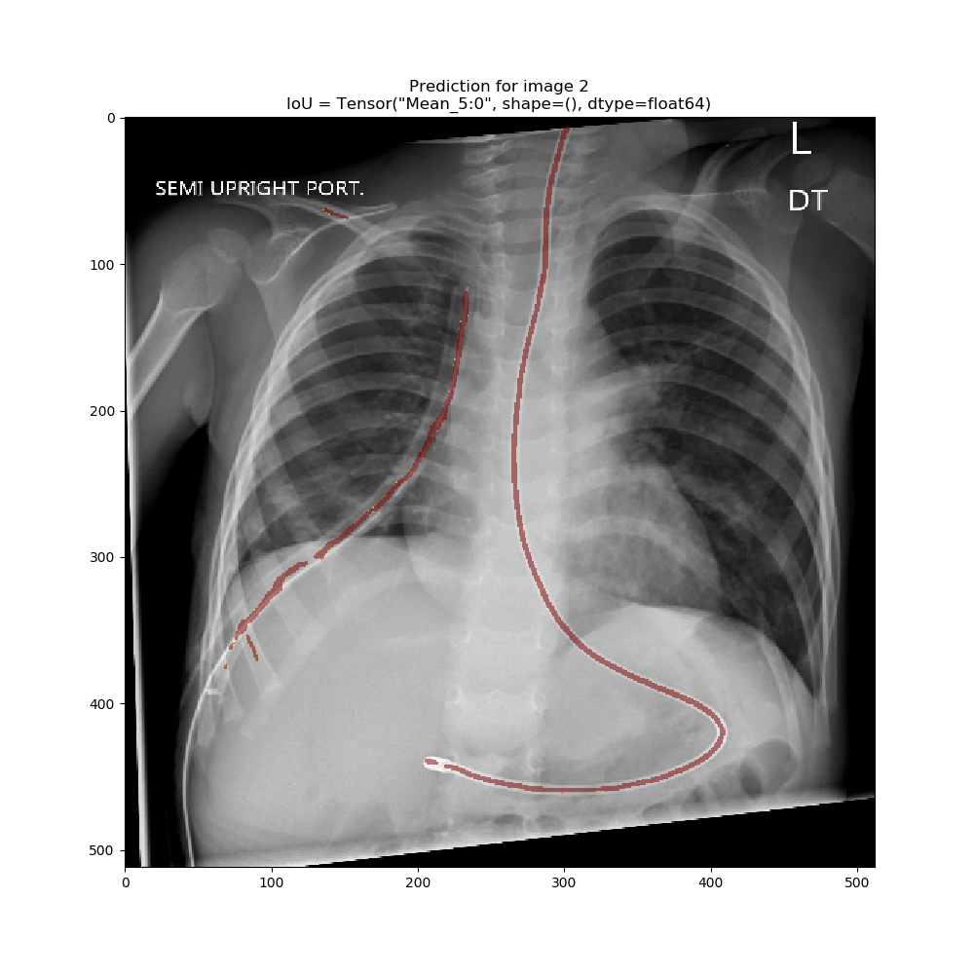



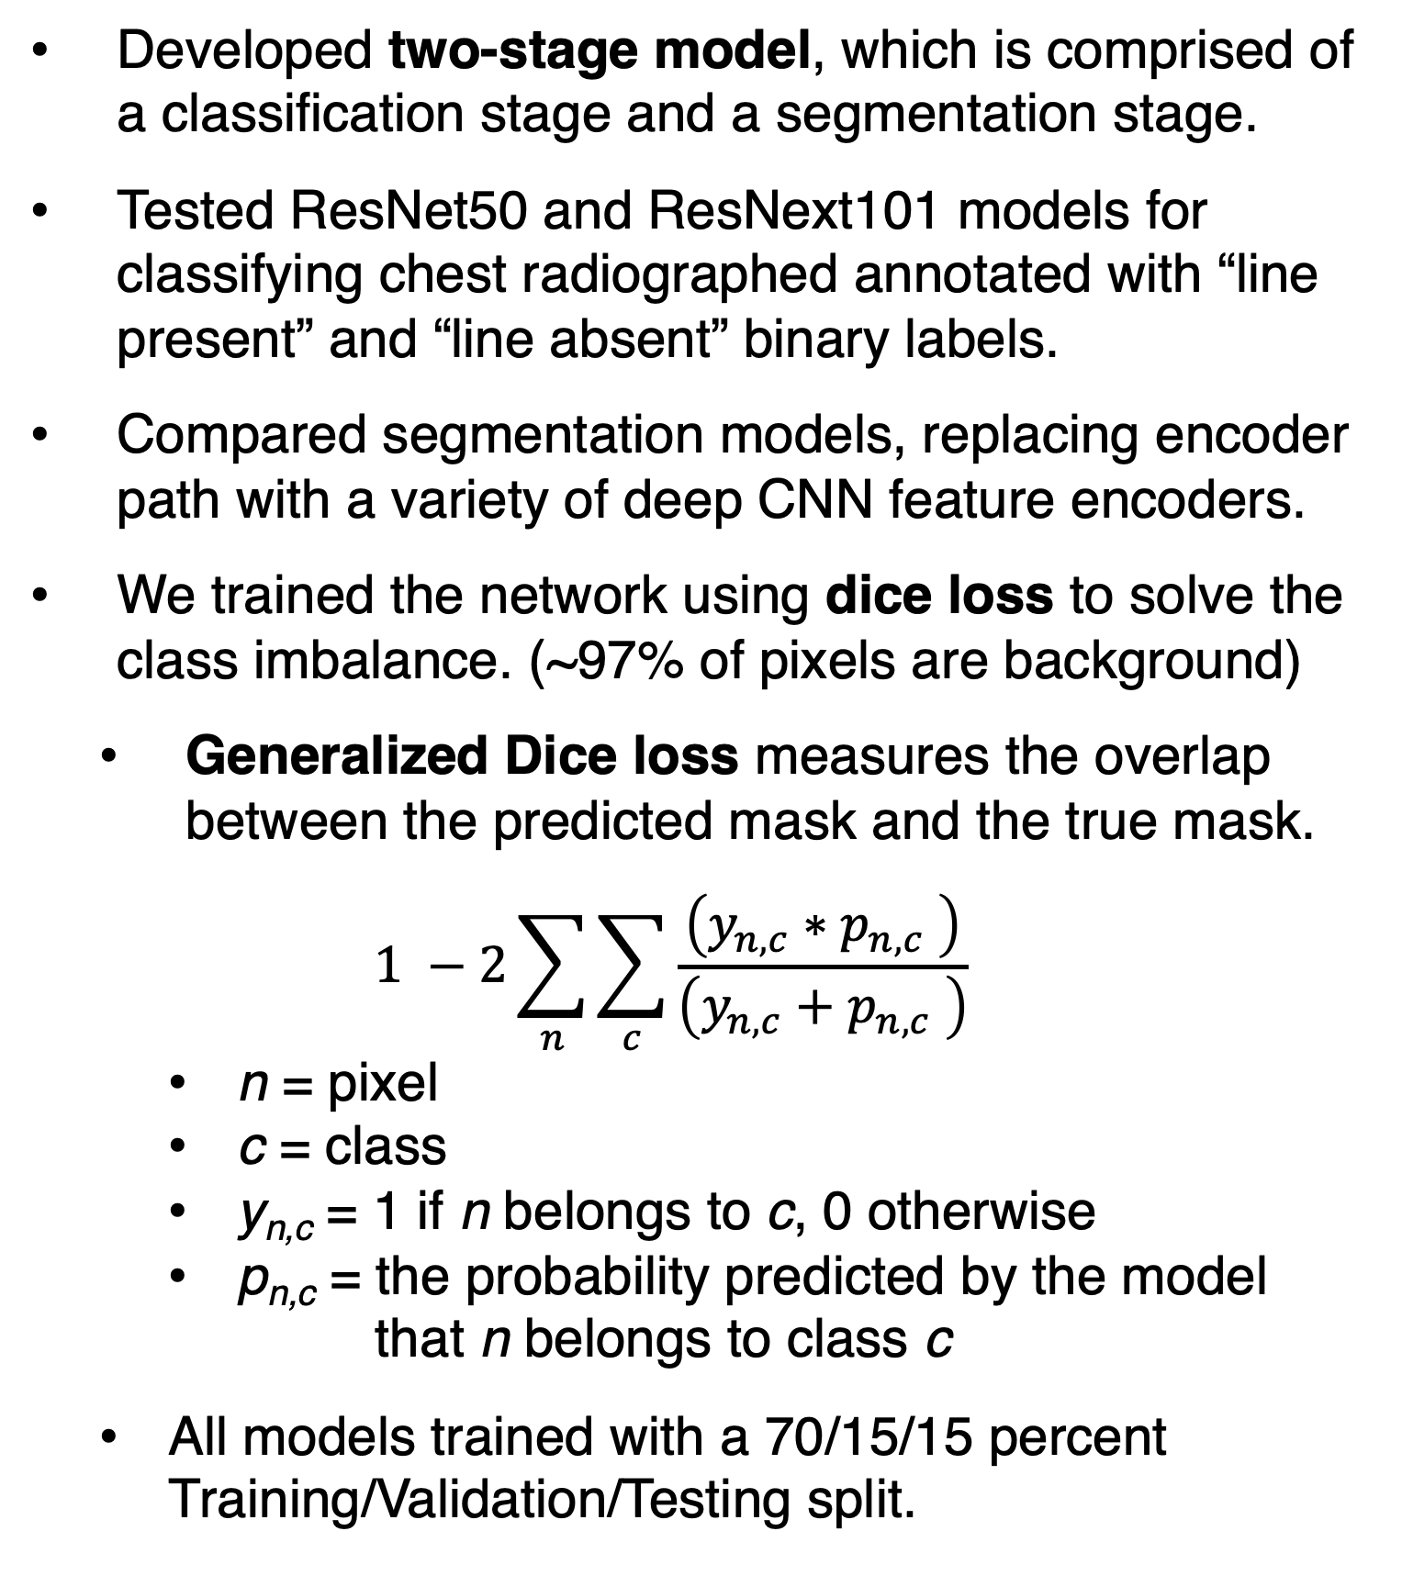
Deep Learning Methods for Segmentation of
Lines in Pediatric Chest Radiographs
Ryan Sullivan¹, Greg Holste², Adam Alessio³
¹Purdue University, ²Kenyon College, ³Michigan State University
INTRODUCTION
Our two-stage model automatically segments catheters, lines, and tubes
in pediatric chest radiographs.
RESULTS
Catheters, lines, and tubes, collectively called lines, are used in a variety of medical procedures.
Radiologists examine chest radiographs to evaluate the placement of these lines and prevent complications.
Goal: semantically segment lines in pediatric chest radiographs using U-Net style, deep convolutional neural networks
Classification Stage
Goal: Classify line present from line absent image
Dataset of 1102 images (50/50 Line +/-)
Model | Classification Accuracy
ResNet50 | 93.4%
ResNeXt101 | 92.8%
Segmentation Stage
Goal: Segment line in line present image
Dataset of 96 hand annotated samples
SAMPLE PREDICTIONS
Model | Dice Coefficient | IoU (F score)
UNet-ResNet50 | 0.527 | 0.699
UNet-ResNeXt101 | 0.524 | 0.696
UNet-EfficientNetB3 | 0.551 | 0.706
FPN-ResNet50 | 0.498 | 0.676
FPN-ResNeXt101 | 0.492 | 0.675
FPN-EfficientNetB3 | 0.508 | 0.684
True line mask A
True line mask B
True line mask C
METHODS
Developed two-stage model, which is comprised of a classification stage and a segmentation stage.
Tested ResNet50 and ResNext101 models for classifying chest radiographed annotated with “line present” and “line absent” binary labels.
Compared segmentation models, replacing encoder path with a variety of deep CNN feature encoders.
We trained the network using dice loss to solve the class imbalance. (~97% of pixels are background)
Generalized Dice loss measures the overlap between the predicted mask and the true mask.
$$1 −2\sum_{n}{\sum_{c}{\frac{\left(y_{n,c}∗{ p}_{n,c} \right)}{\left(y_{n,c}+p_{n,c} \right)}}}$$
n = pixel
c = class
y_{n,c} = 1 if n belongs to c, 0 otherwise
p_{n,c} = the probability predicted by the model
that n belongs to class c
All models trained with a 70/15/15 percent Training/Validation/Testing split.
Using the Resnet50 classification model and the U-Net with EfficientNet-B3 backbone, we construct our two-stage model.
Trained and tested with dataset of 196 samples, 50% with lines present, all annotated for segmentation.
a) ResNet50 Prediction
b) ResNeXt101 Prediction
c) EfficientNet B3 Prediction
Model | Dice Coefficient | IoU (F score)
UNet-EfficientNetB3 | 0.698 | 0.623
Two-Stage | 0.737 | 0.666
REFERENCES
Predicted line mask
Predicted line mask
Predicted line mask
Drozdzal, Michal, Eugene Vorontsov, Gabriel Chartrand, Samuel Kadoury, and Chris Pal. “The Importance of Skip Connections in Biomedical Image Segmentation.” ArXiv:1608.04117 [Cs], August 14, 2016. http://arxiv.org/abs/1608.04117.
Ronneberger, Olaf, Philipp Fischer, and Thomas Brox. “U-Net: Convolutional Networks for Biomedical Image Segmentation.” ArXiv:1505.04597 [Cs], May 18, 2015. http://arxiv.org/abs/1505.04597.
Figure 1: These results were obtained by training U-Net models with different encoder backbones on 512 x 512 images. The networks were initialized with ImageNet weights, and achieved dice scores of a) 0.527, b) 0.524, and c) 0.551 respectively on the test dataset.
(Using a 70/15/15 train/validation/test split with n = 96)
We acknowledge support from the iCER ACRES REU at MSU (National Science Foundation grant 1560168) and
NIH National Institute of Child Health & Human Development (R21HD097609)
Scan this QR code for
more exact information,
extra figures, and
omitted experiments.

